Slide 1
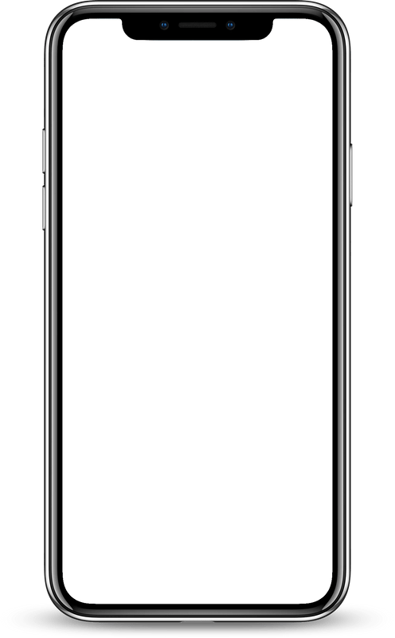

DINE SAFE
Presented By: Gulnur, Leslie, Mohina, and Timur

Slide 2

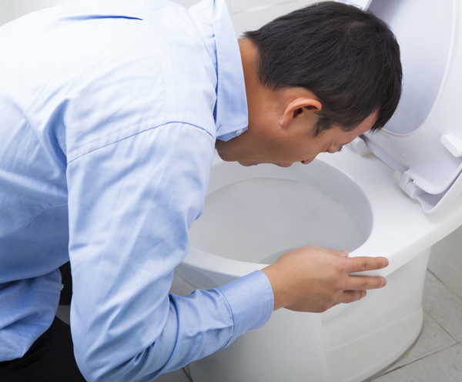
2

Slide 3
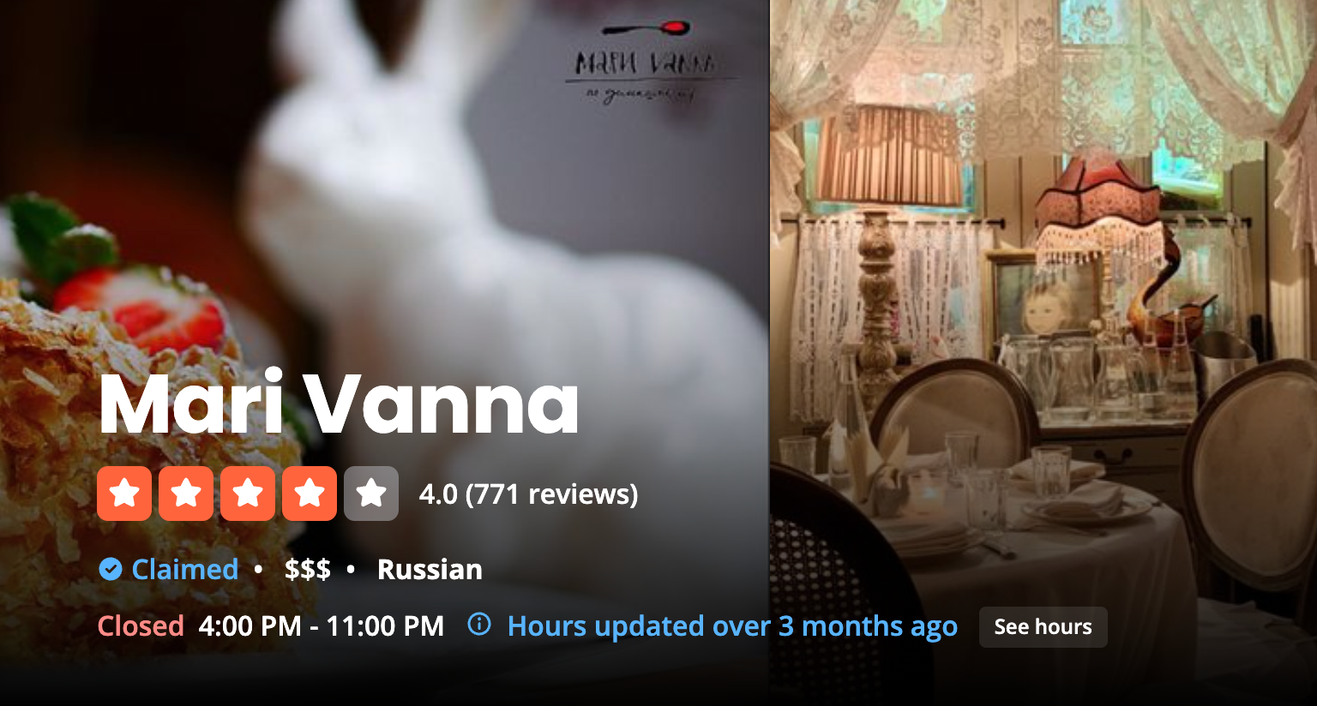
YELP SCORE
NYC INSPECTION
“Food, supplies, and equipment not protected from potential source of contamination”
3

Slide 4
Your Guardian to Dining Safe
An app with up-to-date violation data and Yelp Reviews
4

Slide 5
ASKING PRICE
$5 MILLION DOLLARS
5

Slide 6



THE VIOLATIONS
Mice & Roaches
Employees not Hygienic
Health Issues
6
Notes:
"this is why there is a demand for our product"

Slide 7
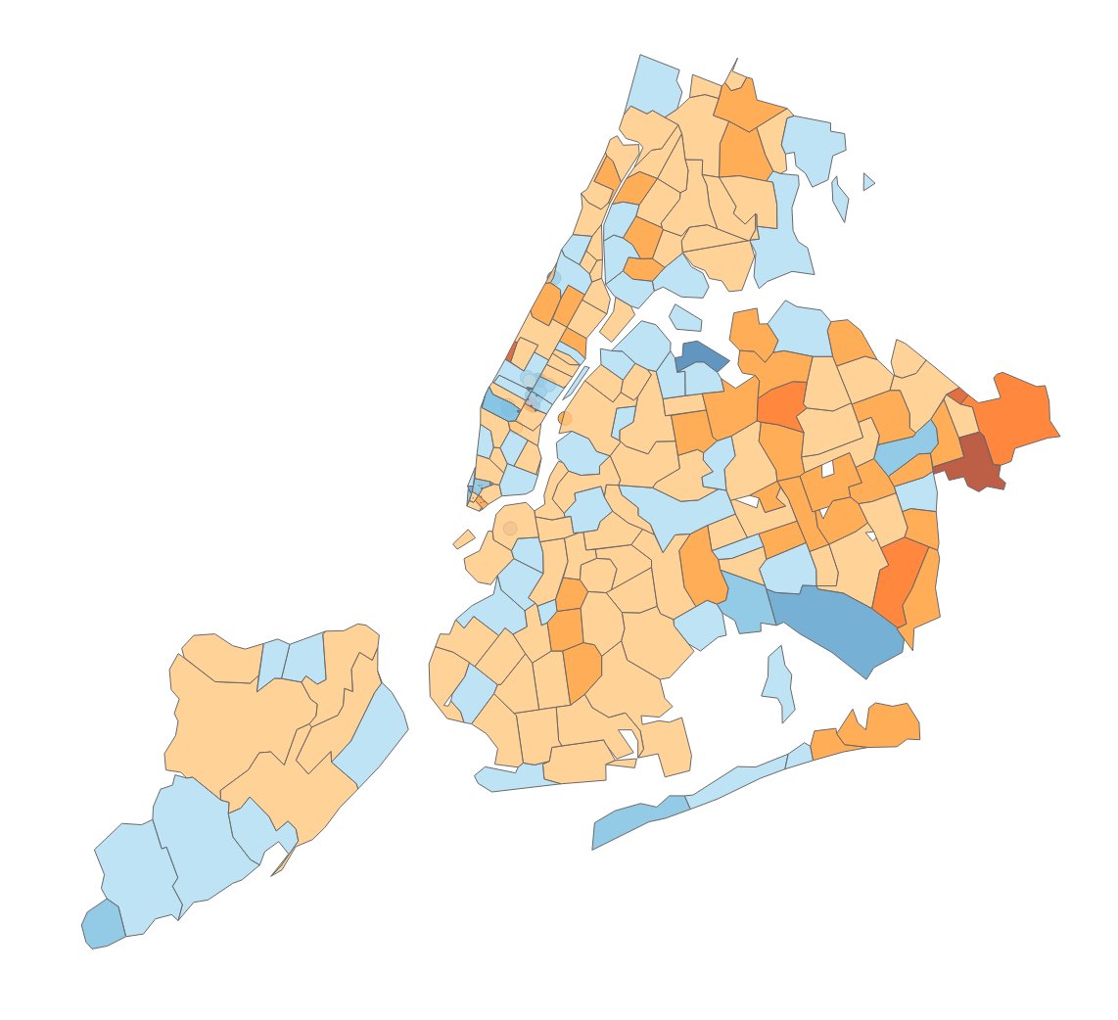
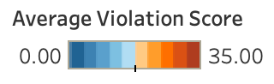
AVERAGE VIOLATION SCORE
BASED ON ZIPCODE
7

Slide 8
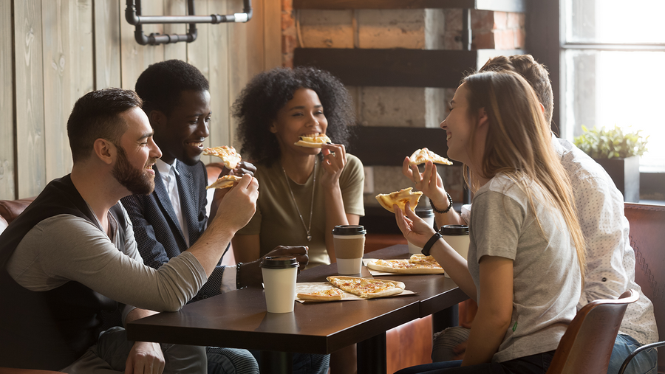
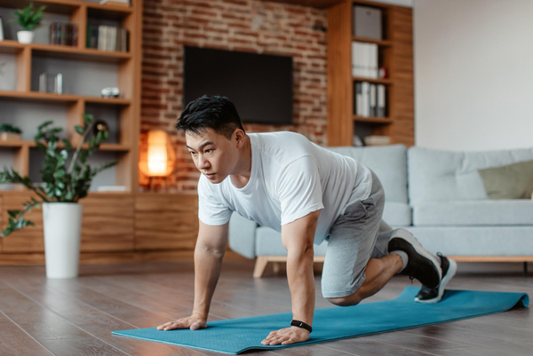

tailored for everyone
Food Lovers
Health Enthusiast
Chefs
8

Slide 9


DATA SOURCES
Updates once a year
92 million users
9

Slide 10
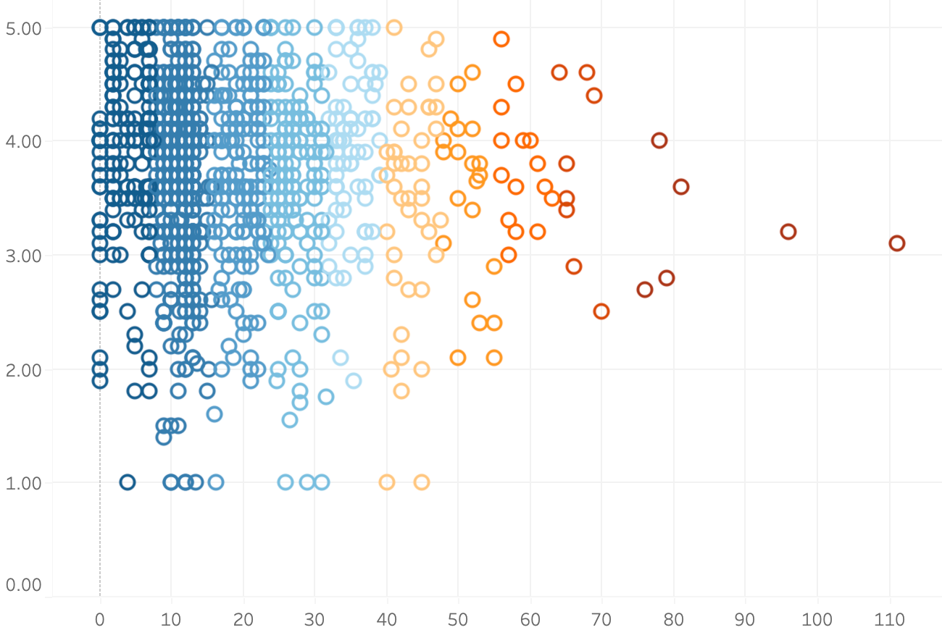
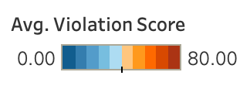
Correlation
Yelp Rating
Violation Score
10

Slide 11
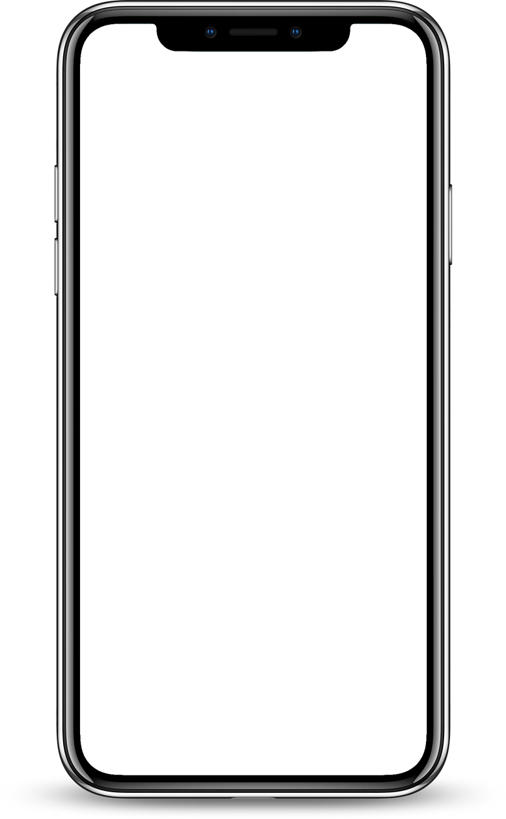
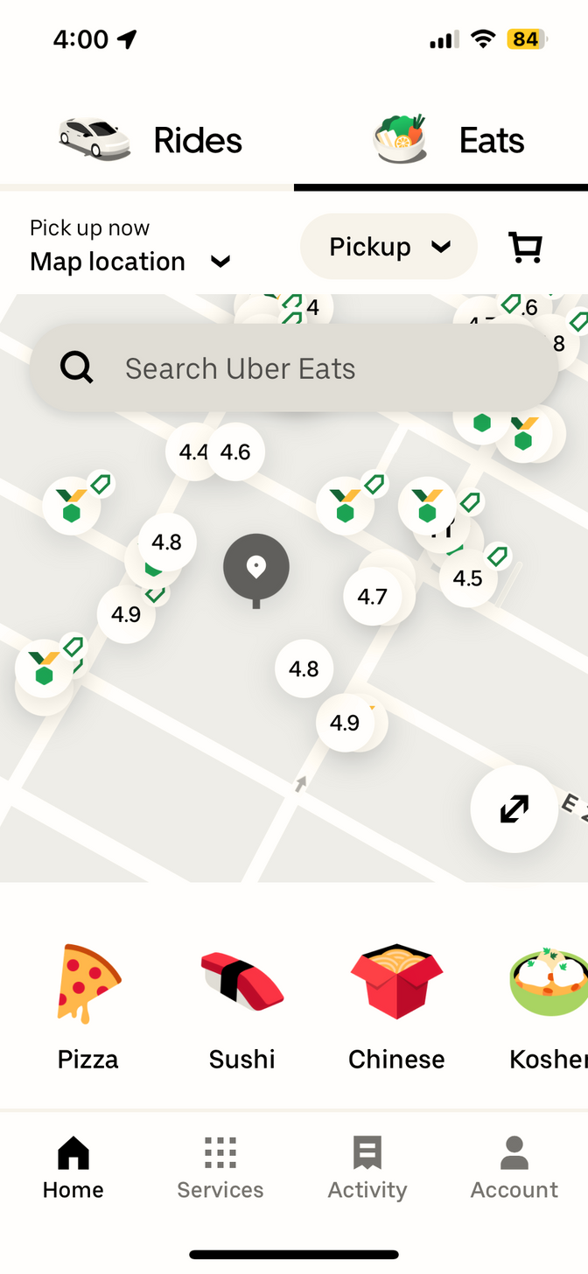






CUISINE
RESTAURANTS
SEARCH DINE SAFE
GRADE
A
B
C
OUR INTERFACE
11

Slide 12


APP FEATURES
Fast & Up to Date Violation Information
Audio Feedback for Visually Impaired people
Customizable User Profile
12

Slide 13





Engineered for excellence
Storage
Data warehouse
14

Slide 14



Company RISKS
Expensive Storage
Lack of Specialists
Marketing Expenses
15

Slide 15
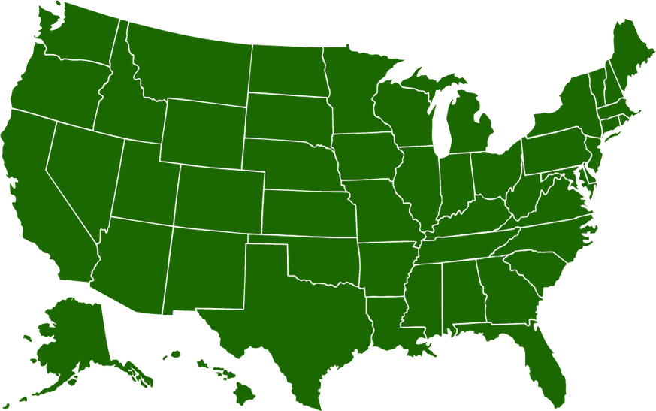



Plans for the future
Expand Nationwide
Partnerships
16

Slide 16


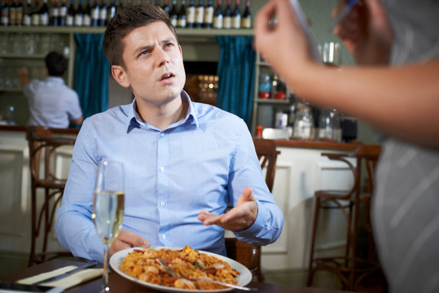
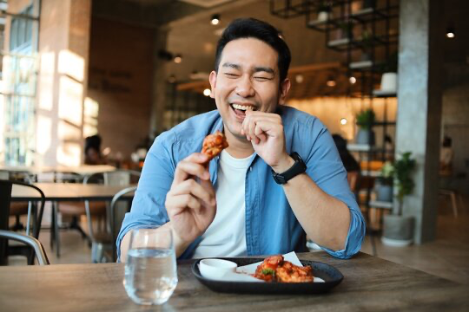
Before
After
Uncertain and risked
Confident and informed
17

Slide 17
Q&A
18

